Slide 1
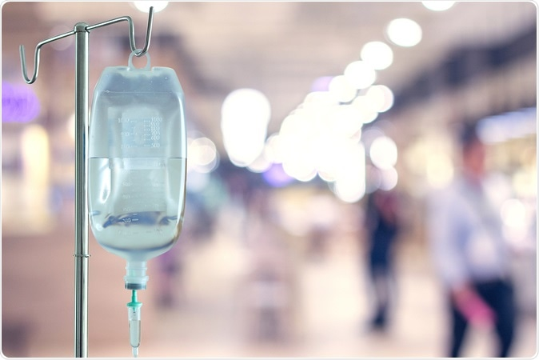

MEET THE TEAM & ROLES
TEAM NAME : PEARLS(TEAM – 22)
M. Lahari
Designing and Research
A.Samanvitha Narayani
Implementation
Sk.Sameera
Hardware and Software requirements
I.Prathima
Equipment model
G.Prathyusha
Literature Survey
P.Trisha
Equipment model analysis

Slide 2
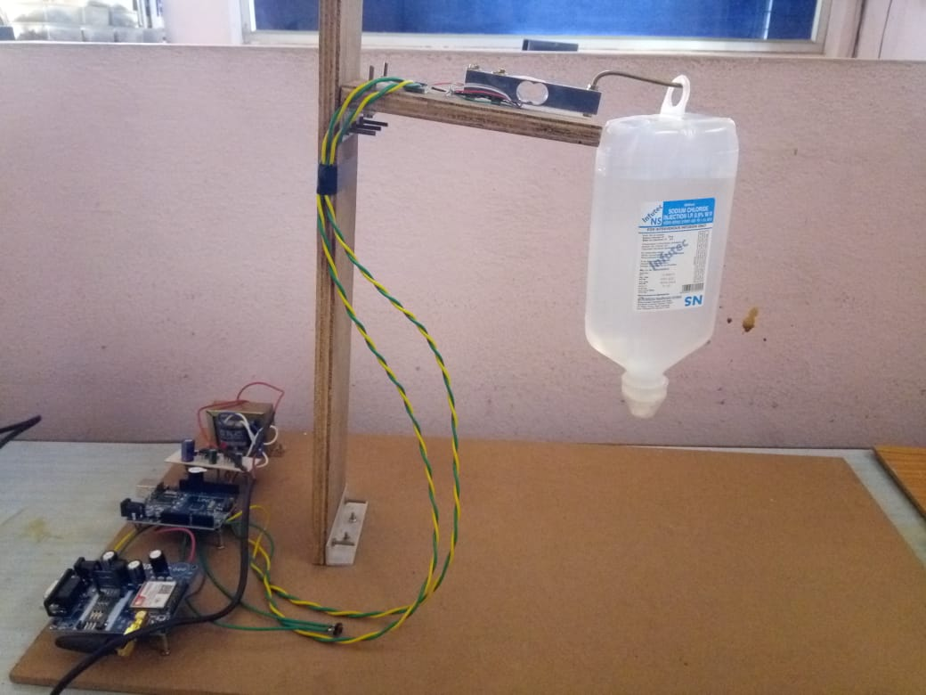
SALINE LEVEL DETECTING SENSOR

Slide 3
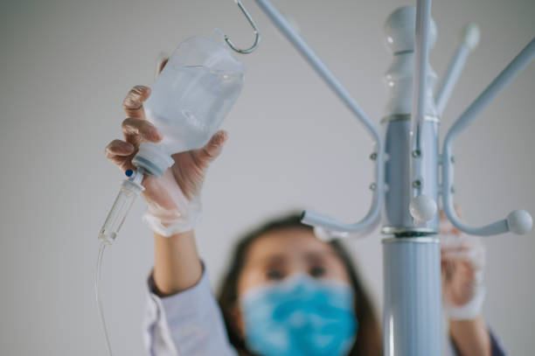
Problem Statement
In a hospital setting, there is a need for a reliable system to monitor the administration of saline solutions to patients. Without proper monitoring, there is a risk of forgetting to replace an empty saline bottle, which can potentially harm the patient.

Slide 4
Aim of the project
This project aims to alert the caretaker in the hospitals when the saline level in the saline bottle becomes low. Here we discuss about the design & implementation of Smart Saline Bottle for Hospitals and Clinics. The user’s system will have the details about saline level in the bottle. The saline level is updated and subsequently sent to the Thing Speak platform. The user can monitor the saline level based on the updated value in Thing Speak and when it becomes low ,nurse can change it before it becomes empty
Buzzer is provided to alert the other nurse in the ward if the saline bottle is not changed until it reaches the threshold.

Slide 5
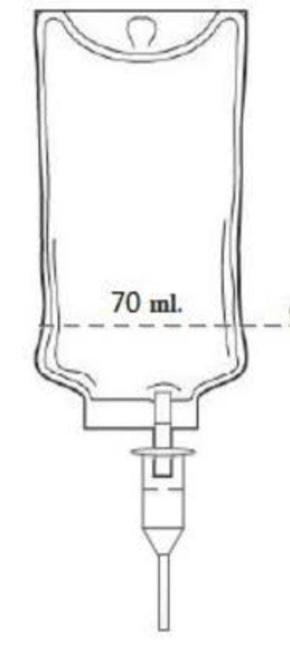
Why this problem occurs
Lack of Integration and Automation
Manual methods like paper logs or standalone electronic records cause communication gaps and hinder real-time tracking of saline usage.
Lack of Standardized Protocols
Hospitals lacking standardized protocols for saline monitoring and replacement risk inconsistency, confusion, and errors among healthcare teams.
Complex and Demanding Work Environment
Hospital staff face fast-paced, high-stress environments, attending to multiple patients and medical tasks. Overlooking saline monitoring risks patient safety.

Slide 6

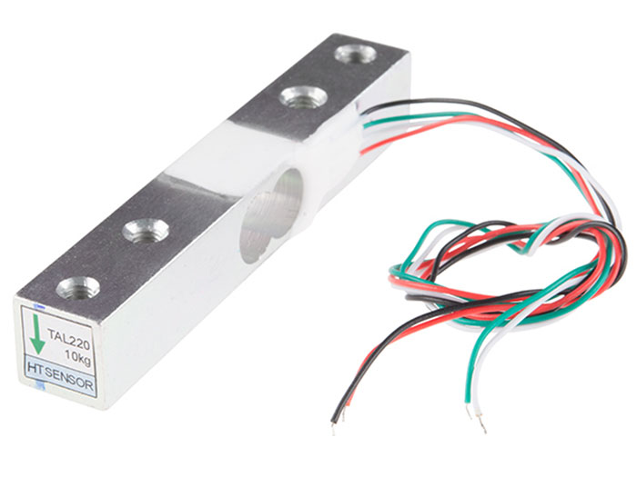
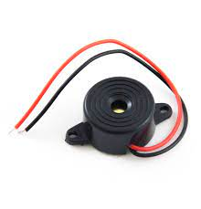
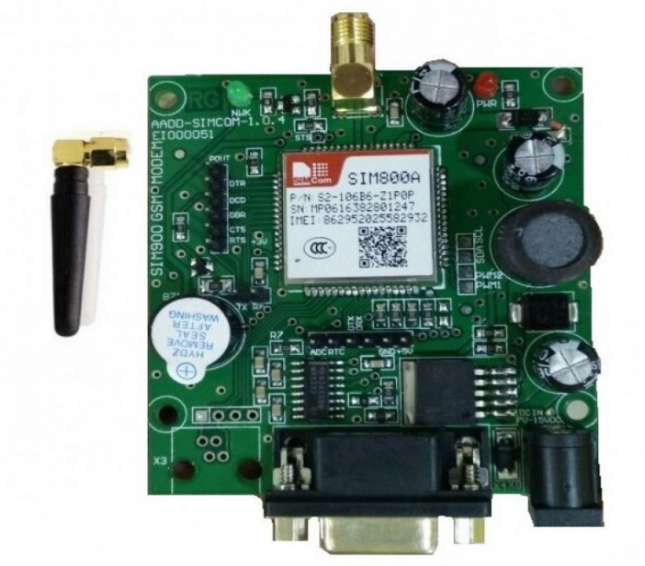
Working
The system comprises an Arduino controller interfacing input and output modules, acting as a control unit. The input module is a Load Cell sensor on the Saline Stand, sensing saline levels and sending data to the controller. The GSM module facilitates communication between the controller and the monitoring department, displaying saline levels on ThingSpeak. Users receive SMS alerts when levels are low, prompting them to change the bottle to avoid reverse blood flow. A buzzer alerts nurses until the new bottle is in place, ensuring patient safety.
Arduino UNO
Load Cell Sensor
Buzzer
GSM module

Slide 7
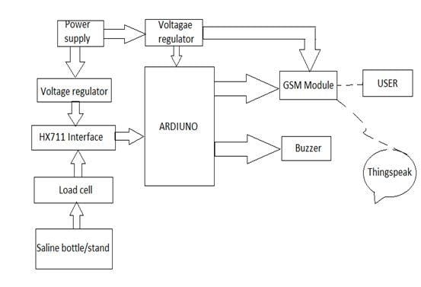
Saline Level monitoring system
In this block diagram we see GSM module to send SMS to the user and Load Cell to sense the volume of saline in the saline bottle, arduino microcontroller where data is processed all these combinely working together makes the process of alerting the nurse through buzzer and SMS makes the process easier.

Slide 8
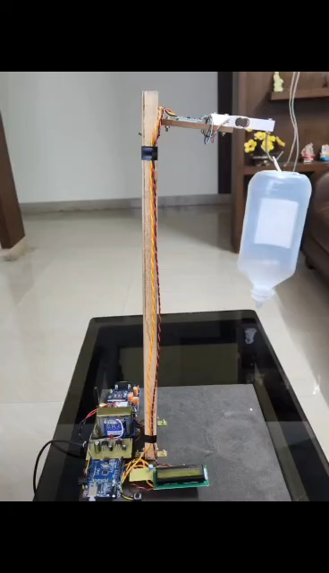
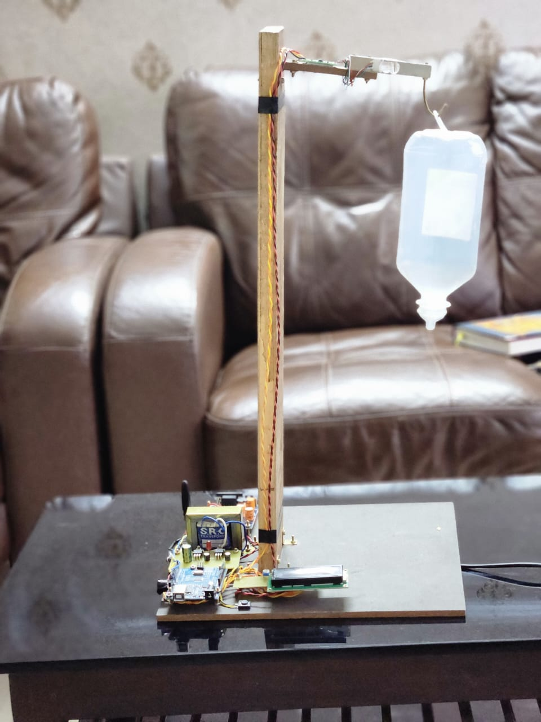
Result
final module
Click the below video

Slide 9
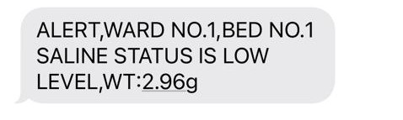
Solution
The Load cell is used for sensing the saline level in the saline bottle so that the it can be monitored continuously. The implementation of the circuit is made as the saline level is continuously and when the saline level becomes low an SMS is sent to user through GSM module and others are alerted using Buzzer if no one changes the saline bottle.

Slide 10
LEARning from hackathon
• As a team, we learned to work together and acquired technical skills to complete the task successfully.
• Implementing our creative ideas through coding improved our problem-solving abilities.
• During the presentation, we gained clarity on how to explain things from a user's perspective, making it easier to understand.
• Contributing to social causes increased our sense of responsibility towards those in need.

Slide 11
Future work
1.Improving the model's accuracy.
2.This project can further be improved using various sensors that senses the patients pulse rate and blood pressure etc.., help in development of more efficient care for the patient in case of emergency
3. Future saline level sensors might be designed to perform self-calibration and self-maintenance to reduce the need for frequent manual calibrations and increase long-term accuracy.
4. Saline level sensors could be equipped with automated data logging and maintenance systems, allowing healthcare facilities to monitor sensor performance, track usage, and schedule maintenance efficiently.

Slide 12


